Slide 1


HVS​
Concept of Mode Management

Slide 2

Contents
Vehicle Drive Status Control
Manual driving mode selection

Slide 3
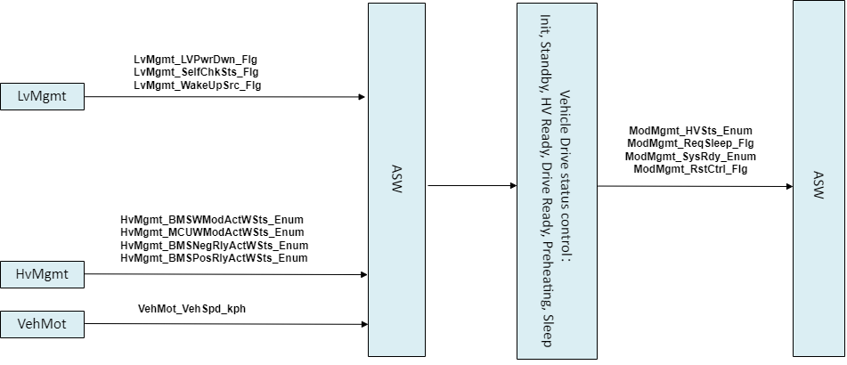
Vehicle Drive Status Control
diagnosis

Slide 4
Vehicle Drive Status Control
Init
LV Power Down Active
Sleep
LV Power Down Inactive
LV Power Down Active
Self Check Pass
Standby：Req Sleep
No wake up and veh speed low
Standby
BMS Active And MCU Ready
BMS Inactive And MCU Standby
BMS Inactive And MCU Standby
BMS NegRly Open
HV Ready
Preheating
BMS NegRly Close
MCU TrqCtrl
MCU Ready
Drive Ready

Slide 5
Manual driving mode selection selectiondiagnosis
Manual driving mode selection
Functional logic description
a、Determine the driving mode of the vehicle based on the driving mode request sent by IVI
b、Determine if there are fault in the driving mode (Mainly whether the battery SOC supports strong acceleration or strong recycling)
Interface
Input：
a、 Comm_IVIDrvModSet_Enum、 Comm_BMSDispSOC_Enum、 ModMgmt_ MemDrvMod _ Enum(NVM)、 TorqPahMgmt _ ACLSts _ Enum
Output:
a、 ModMgmt_ActDrvMod_ Enum、 ModMgmt_ MemDrvMod _ Enum(NVM)、
ModMgmt_ DrvModSwtWarn _ Flg

Slide 6
Backup

